Slide 1
Data-Driven Extract Method Recommendations: A Study at ING
By David van der Leij , Jasper Binda , Robbert van Dalen, Pieter Vallen,Yaping Luo and Maurício Aniche
Presented by: Pranay Reddy Juturu , Ashay Pable and Diya Sanghvi

Slide 2
Outline
Context
Problem
Solution
Limitations
Approach Overview
Validation

Slide 3
Context
Refactoring is a complex task for a computer
Tedious for programmers
May have varying ways to implement extract method refactoring
Code smells are a major issue
Hesitation toward fixing code smells

Slide 4
Problem
Identification of refactoring opportunities.
Refactoring involves challenges such as identifying where and how to refactor, estimating the costs and benefits of refactoring and validating the correctness of refactoring.

Slide 5
Solution
Data-driven approaches based on machine learning models to recommend methods that should undergo Extract method refactoring.
Extract method refactoring is breaking down the long and complex methods into simple and small methods to improve the code quality.
Six different machine learning models were used. (Random Forest, Logistic Regression, KNN, Decision Tree, Naive bayes and SVM)
Code metrics were used as features to the predict if a piece of code should be refactored.
Notes:
Logistic Regression,KNN,Decision Tree,Random Forest,Naive bayes and support vector machine

Slide 6
Limitations
Due to varied coding styles and standards, using open-source systems as training data may introduce bias into the models. Experts may employ manual validation, which could lead to subjectivity and inconsistent feedback.
The study did not take into account other factors like code smells, comments, naming conventions, etc. and simply used code metrics as features for the machine learning models.

Slide 7
Approach Overview
Six open-source systems and four ING systems that had Extract Method refactorings performed were selected. Code metrics are extracted before and after refactoring each method.
Statistical tests and effect sizes were used to compare the code metrics distributions of open-source and ING systems. There were some disparities in the distributions of some metrics, such as lines of code, parameter count, and cyclomatic complexity.
The machine learning models were trained with open-source data and ING data was used as test set. F1 -score is considered as the primary metric in assessing the model’s performance.
The best performing model (Random Forest) was chosen and generated 100 recommendations for Extract Method refactoring. 12 ING experts were asked to rate each recommendation on a scale of 1 to 5.
Notes:
Logistic Regression, Decision Tree, Random Forest, Support Vector Machine, K-Nearest Neighbors, and Naive Bayes

Slide 8
Validation
RQ1: How Does Code That Underwent an Extract Method Refactoring in ING and Open-Source Systems Compare in Terms of Code Metrics?
RQ2: How Effective Are Supervised Machine Learning Models at Predicting Extract Method Refactoring Opportunities in ING?
RQ3: Do ING Experts Deem Recommended Extract Method Refactorings Useful/Not Useful?

Slide 9
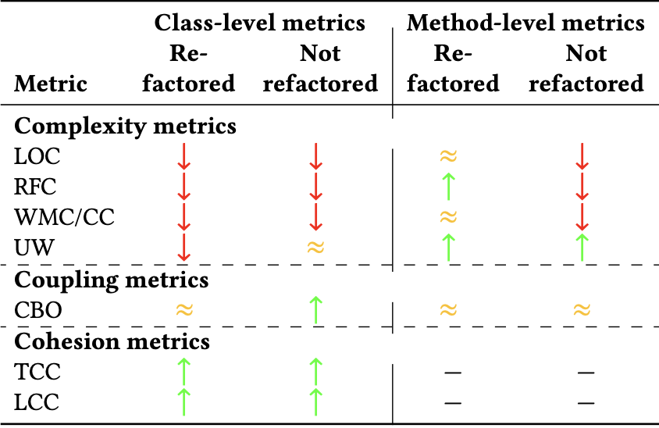
RQ1: How Does Code That Underwent an Extract Method Refactoring in ING and Open-Source Systems Compare in Terms of Code Metrics?
Classes in open-source systems tend to be larger and more complex than classes in ING systems that contain methods that through an Extract Method. Methods that experienced an Extract Method in both ING and open-source are often similar in size and complexity.
Between classes and methods that underwent an Extract Method in ING and in open-source, coupling is typically similar.
The metrics discrepancies between ING and open source systems typically occur more noticeably at the class level and are less at the method level. Hence, they predicted that a model developed from open-source data will perform as expected.

Slide 10
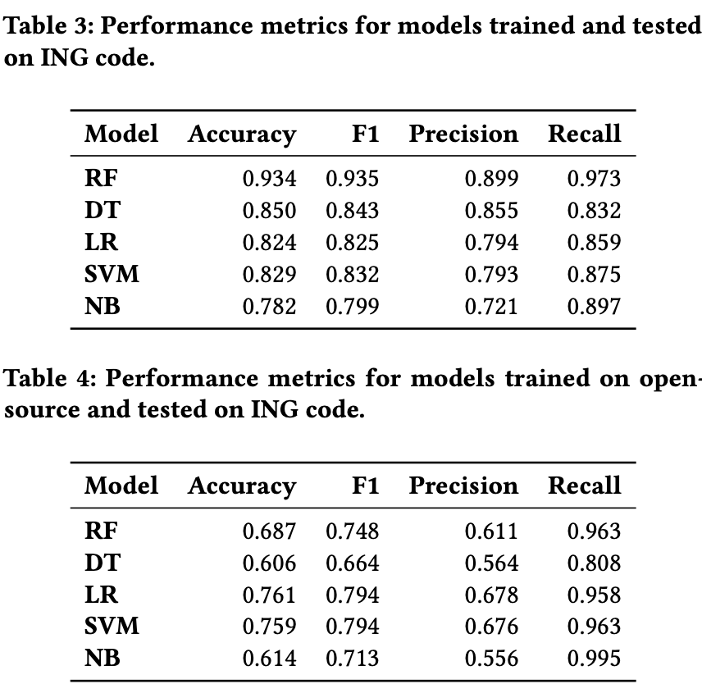
RQ2: How Effective Are Supervised Machine Learning Models at Predicting Extract Method Refactoring Opportunities in ING?
All of the various machine learning models function reasonably well.
Random Forest outperforms all others. The values for accuracy, F1, precision, and recall are 0.934, 0.935, 0,899, and 0.973, respectively.
In comparison to other types of models, Random Forests are more stable in terms of performance when permuting features.

Slide 11
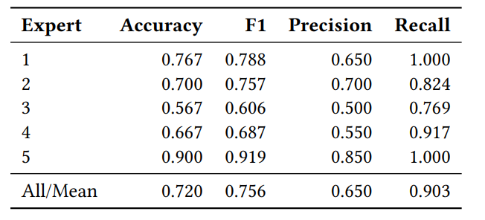
RQ3: Do ING Experts Deem Recommended Extract Method Refactorings Useful/Not Useful?
Extract Method agreement (𝑅𝐴) - TP
Extract Method disagreement (𝑅𝐷 ) - FP
Non-refactor agreement (𝑁𝐴) () - TN
Non-refactor disagreement (𝑁𝐷 ) - FN
Evaluation Metrics
Accuracy - (RA + NA)/(RA+NA+RD+ND)
Precision - RA/(RA + RD)
Recall - RA/(RA + ND)
F1 Score - RA/(RA+(RD+ND)/2)

